Slide 1

Parameter Changing
&
Degradation Reason

Slide 2
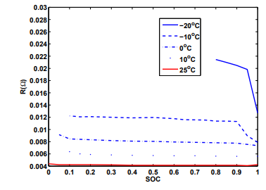
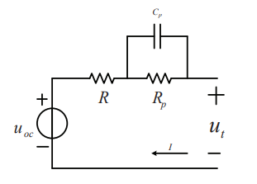
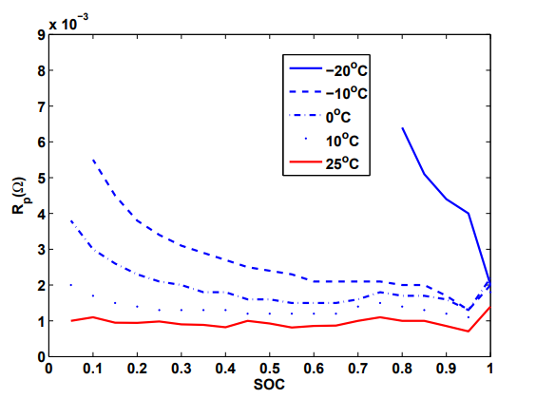
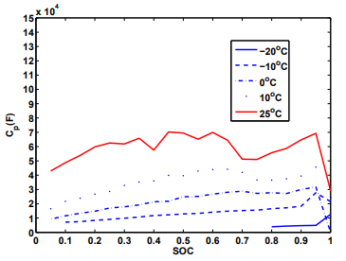
Parameter Changing during One Cycle
R, Rp, Cp are all sensitive to temperature
R is not sensitive to SOC, especially 10-90%
Rp decreases when SOC become larger
Cp increases slightly when SOC become larger
Y Zhang. "Parameters Identification and Sensitive Characteristics Analysis for Lithium-Ion Batteries of Electric Vehicles." Energies 11.1(2017):19.

Slide 3
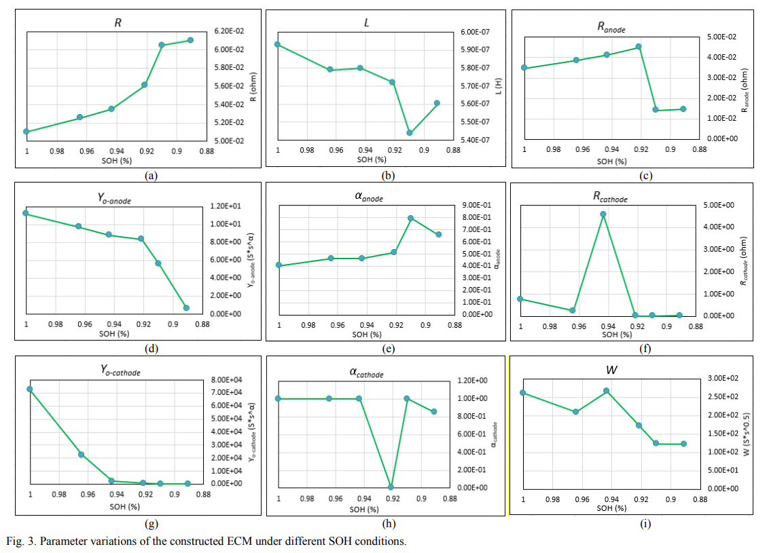
Parameter Changing
The internal resistance keeps growing.
The capacity goes down.
Xia, Z. , and J. Qahouq . "Evaluation of Parameter Variations of Equivalent Circuit Model of Lithium-ion Battery under Different SOH Conditions." 2020 IEEE Energy Conversion Congress and Exposition (ECCE) IEEE, 2020.

Slide 4
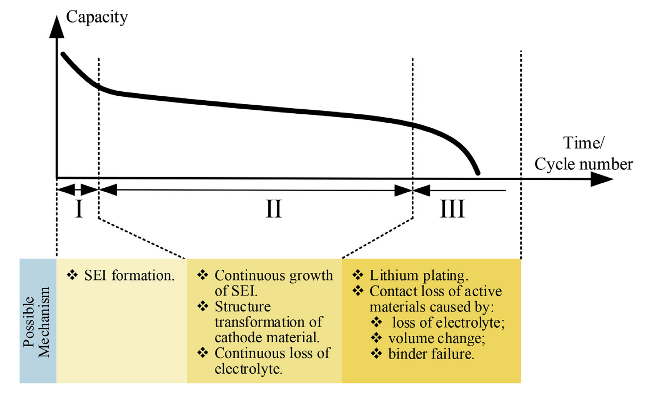
Degradation Reason
Loss of lithium ion inventory (LLI)
Loss of anode/cathode active materials (LAM)
Loss of electrolyte (LE)
Under Discharge (UD)
Xuebing, et al. "A review on the key issues of the lithium ion battery degradation among the whole life cycle - ScienceDirect." eTransportation 1:100005-100005.

Slide 5
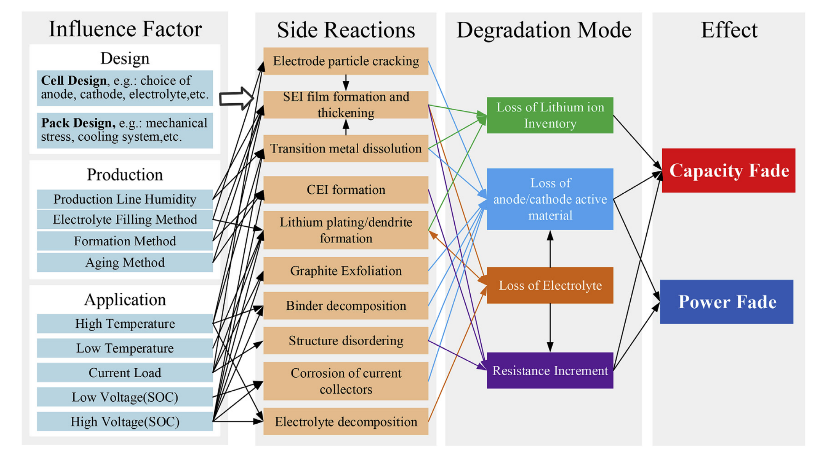
Details
Xuebing, et al. "A review on the key issues of the lithium ion battery degradation among the whole life cycle - ScienceDirect." eTransportation 1:100005-100005.

Slide 6
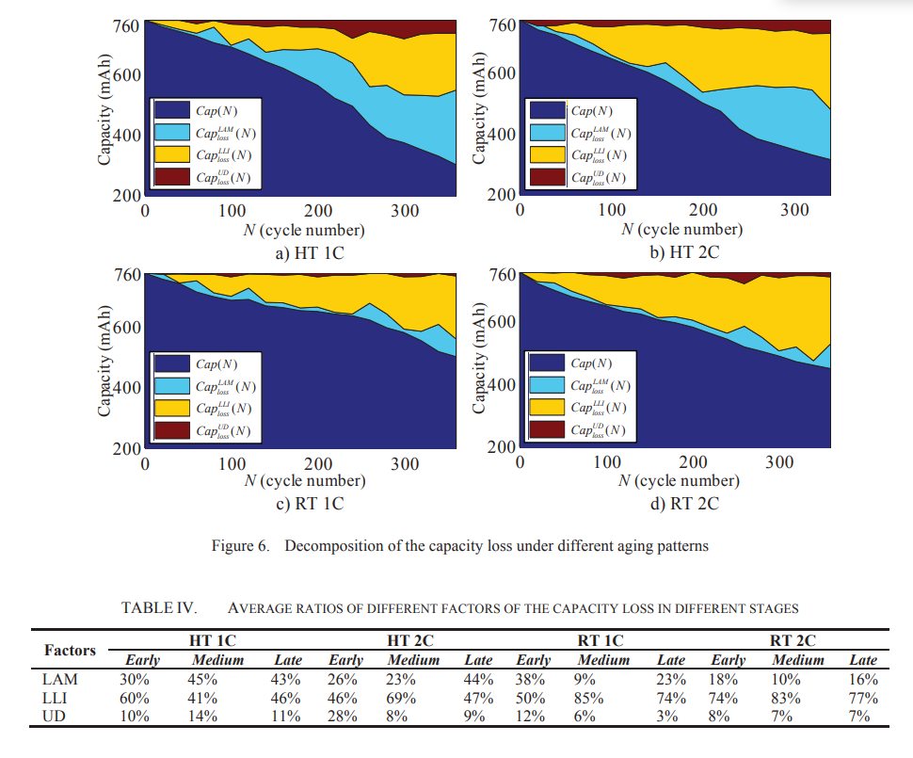
Capacity Fade
LAM and UD parts are larger in higher temperature
LLI parts increase linearly
LAM increases greatly in late part
Zhang, L. , J. Li , and L. Chao . "A novel method for capacity fade analysis of lithium-ion batteries based on multi-physics model." IEEE International Conference on Prognostics & Health Management IEEE, 2016.

Slide 7

Thank you!

